Slide 1


Stochastic On Time Arrival Problem
Project Presentation and Viva
S1-G8-ITS
Mentor: Prapti Patel
Abdulwahab Shaikh, Yagnik Trivedi, Dhruvi Chavda
Manthangiri Gosai, Vruddhi Madam
CSE 400: Fundamentals of Probability in Computing

Slide 2
Background and Motivation
The Reality: Real-world road networks are highly unpredictable.
The Flaw: Deterministic algorithms assume fixed travel times, ignoring variance.
The Shift: Moving from optimizing for the fastest average route to the most reliable route.
The Impact: Critical for high-stakes scenarios (e.g., emergency services, strict deadlines).

Slide 3
Base Paper Overview
Complex Stochastic Graph
Reference: Tractable Pathfinding for the SOTA Problem (Niknami & Samaranayake, 2016).
The Challenge: Exact SOTA algorithms are computationally intractable on large city networks.
The Core Contribution: Utilizing the exact "policy-based" SOTA solution as a mathematical heuristic for an A* search.
The Result: Makes probabilistic routing computationally feasible for real-world applications.
Policy-Based SOTA Heuristic + A* Search
Tractable Optimal
Path

Slide 4
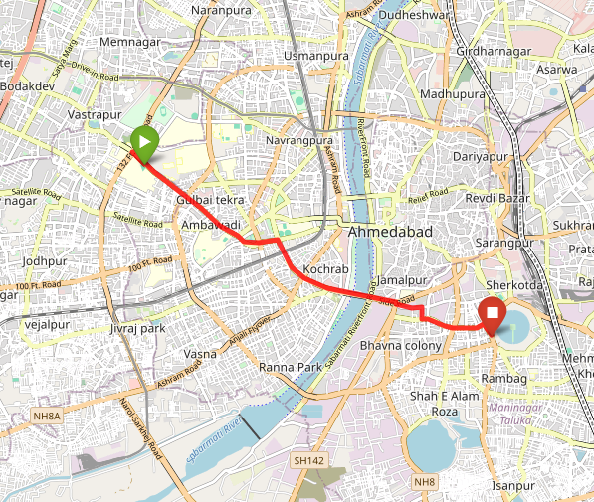
Problem Formulation
• Road network → Graph G(V, E)
• Each edge has stochastic travel time
• Given:
- Source s
- Destination d
- Time budget D
• Objective:
maximize P(T ≤ D)
T: Total travel time
• Goal: maximize reliability instead of expected time
• Path must be fixed before travel (Path-based SOTA)
Example of real-world route computed by our model
IIM Ahmedabad → Kankaria Lake

Slide 5
Mathematical Model - 1 - Jensen Inequality
• Edge travel time:
Mean μ, Variance σ²
• Assumption:
Edge travel times are independent
• Total path:
Mean = sum of means
Variance = sum of variances
• Reliability:
P(T ≤ D) = Φ((D − μ)/σ)
• Jensen’s Inequality:
f(E[T]) ≠ E[f(T)]
⇒ minimizing expected time ≠ maximizing reliability

Slide 6
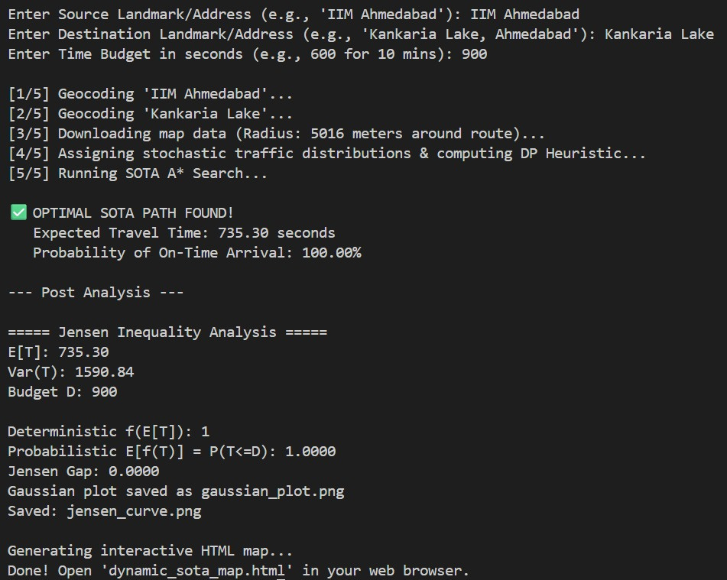
Mathematical Model - 2 - Excess Time Budget

Slide 7
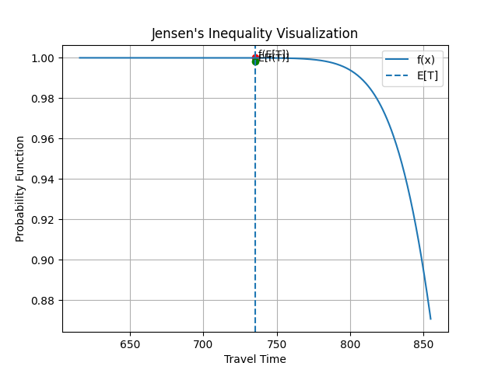
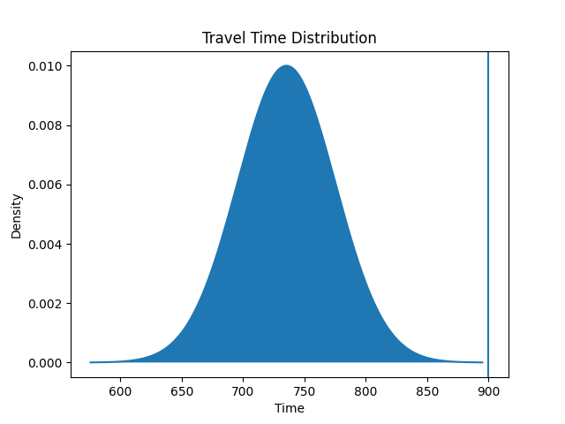
Mathematical Model - 3 - Excess Time Budget

Slide 8
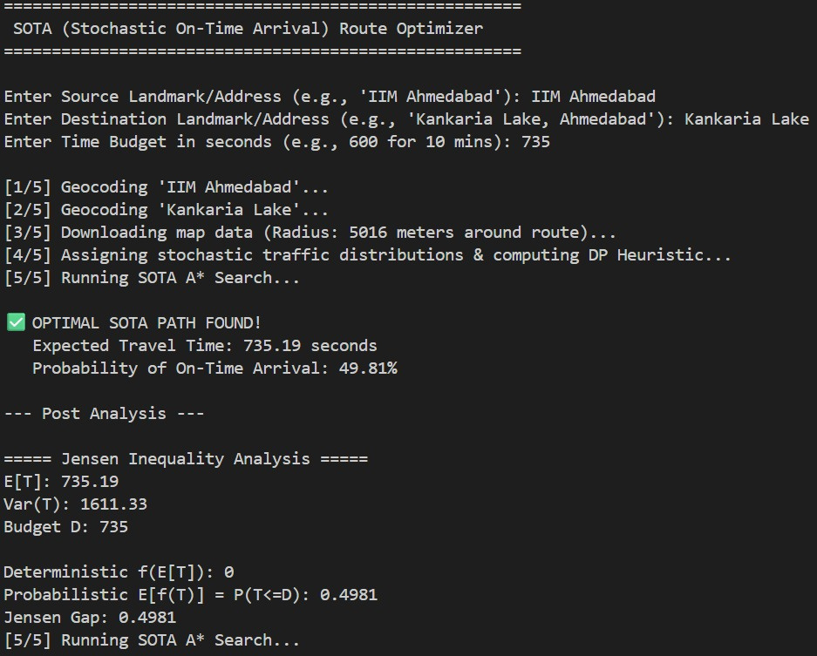
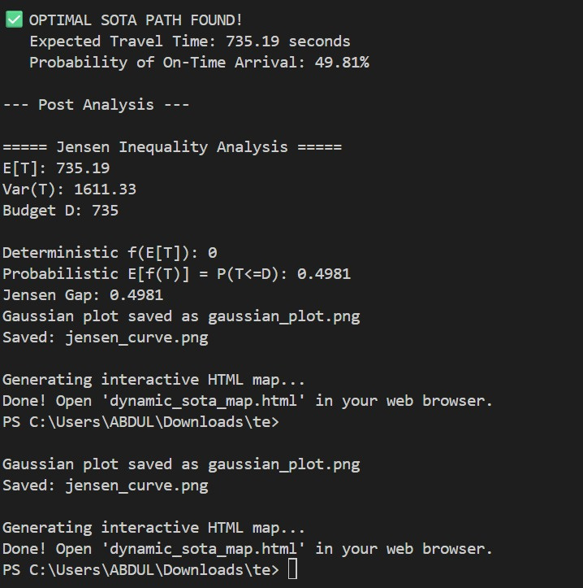
Mathematical Model - 4 - Tight Time budget

Slide 9
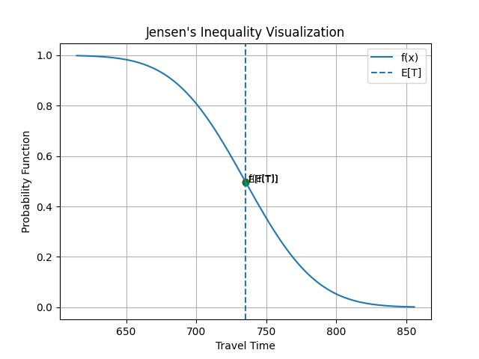
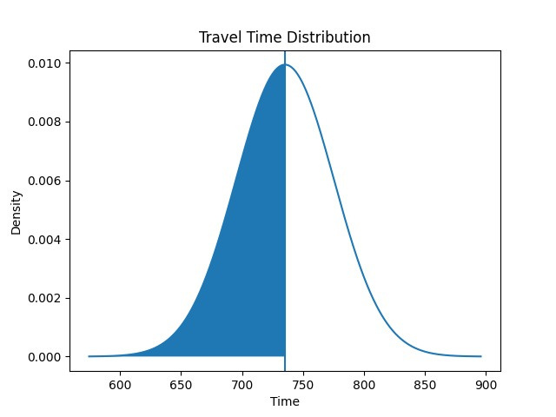
Mathematical Model - 5 - Tight Time budget

Slide 10
Deterministic Approach - 1
Introduction
Converts a stochastic (random) network to a static, deterministic model.
Formulates a road network as a graph G(V, E).
Assigns Expected Travel Time E[T] to each road.
E[T] = ∑t∙P(t)
Assumes travel times to be fixed constants.

Slide 11
Deterministic Approach - 2
Objective
Objective is to compute the Least Expected Travel Time (LET) path.
Employs Dijkstra’s Algorithm along with a priority queue data structure, heap.
Assigns expected weights to all the edges.
Finds a path with minimum expected travel time.

Slide 12
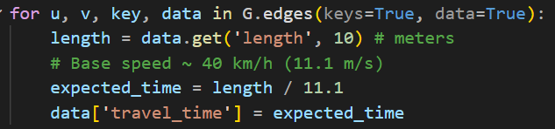
Deterministic Approach - 3
The Mathematical Model
Weighted Directed Graph, G = (V, E)
Deterministic Weight Function : ω
For any edge, ω represents a Fixed and Positive Scalar value.
Distance
ω(u, v) =
Average Speed
Nothing but a Deterministic Routing Problem!
ω(u, v) =
Expected Travel Time

Slide 13

Deterministic Approach - 4
The Mathematical Principle
Bellman’s Principle of Optimality
The principle suggests that:
If a path P is the shortest path between source node 9s) and destination node (d), then any subpath of P is also the shortest path between it’s respective endpoints
Code Snippet (Using Networkx Library):

Slide 14
Randomized Approach - 1
A* Heuristic Algorithm / Path Based SOTA
Policy Based SOTA
Path Search
Priority Queue for the Most Promising Path
Convolution
Dynamic Programming

Slide 15
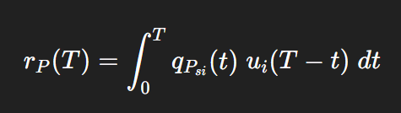
Randomized Approach - 2
Niknami & Samaranayake (2016) propose that the solution to the policy-based SOTA problem is used as a search heuristic
Heuristic:
Can be Interpreted as :
Combines the probability of reaching an intermediate node with the probability of reaching the destination after that

Slide 16
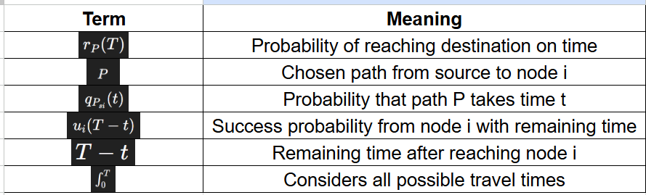
Randomized Approach - 3 - a

Slide 17
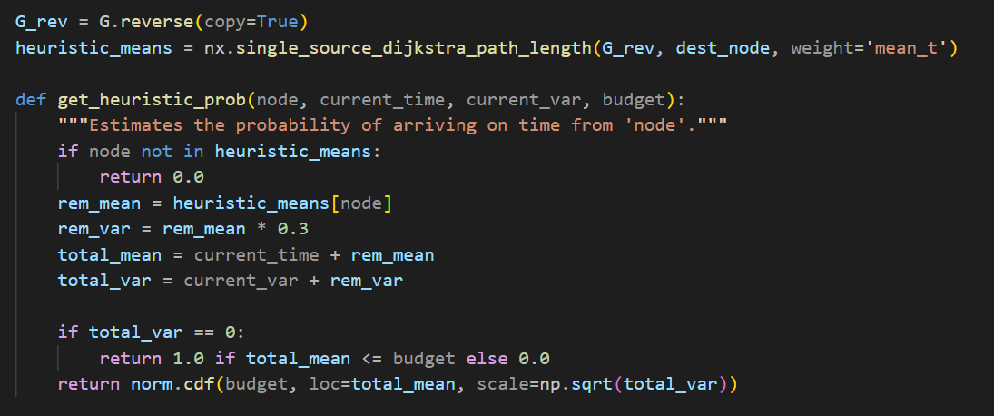
Randomized Approach - 3 - b
Code Snippet:
The Reverse Travel
Decreasing the remaining time left from the budget
Dynamically find the most reliable path
Assort using Priority Queue

Slide 18
Randomized Approach - 4
The Algorithm itself is Partially Random in nature.
Travel times of each node are Random
Algorithm is mixture of Policy Based SOTA and A* Heuristic Path Search
Which gives us the Path Based SOTA

Slide 19
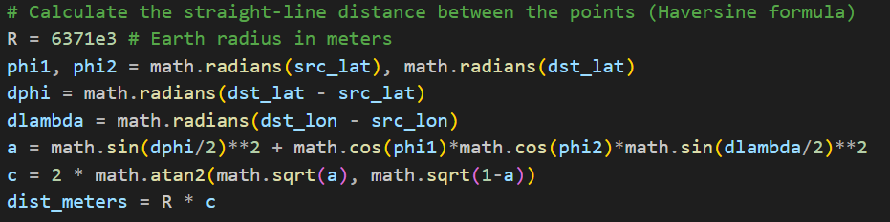

How much map to download ?
We use osmnx (Open Street Map) for geolocation
The downloaded reference should be enough for the source, destination and a little buffer path (1.5 km) for the alternate routes.
Haversine Formula:

Slide 20
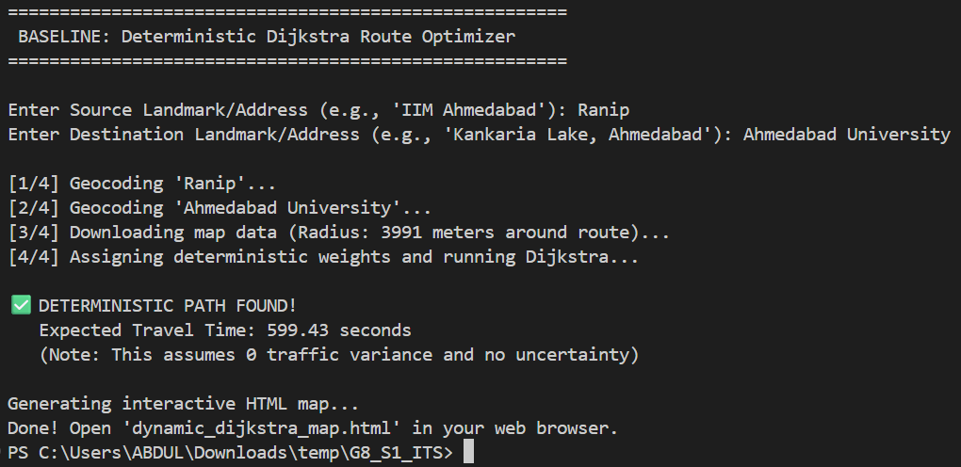
Coding and Simulation - 1 - Deterministic

Slide 21
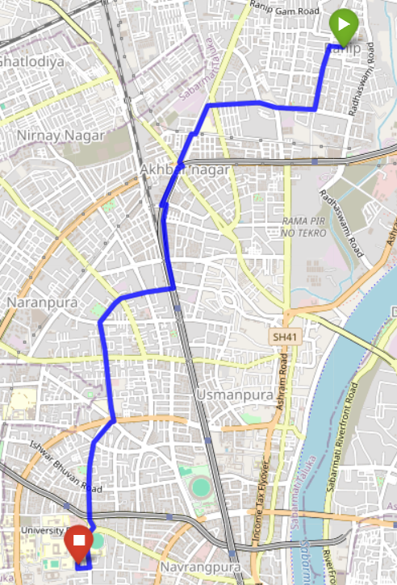
Coding and Simulation - 2 Deterministic Visualization

Slide 22
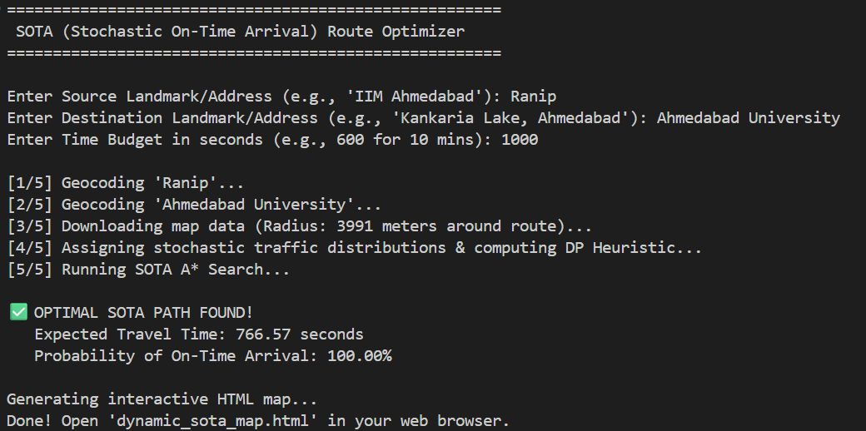
Coding and Simulation - 3 - Randomized

Slide 23
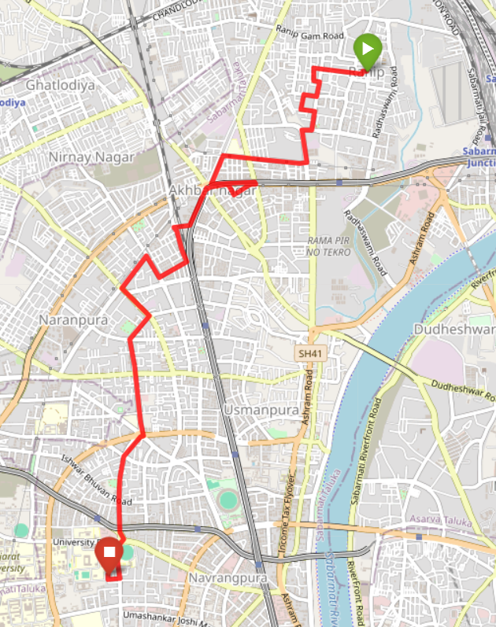
Coding and Simulation - 4 Randomized Visualization

Slide 24



Result - 1
Complexities (Worst Case) and Analysis
Algorithm | Space Complexity | Reason | Time Complexity
Deterministic - Dijkstra |  | Polynomial Operations
Randomized SOTA (A*) |  | Exponential Path Exploration Depending on the Heuristic
V = Number of Nodes
L = Maximum PMF length (tTimewise)
E = Number of Edges
b = branching factor (avg neighbours per node)
k = Number of Waypoint Segments
d = depth (path length)

Slide 25
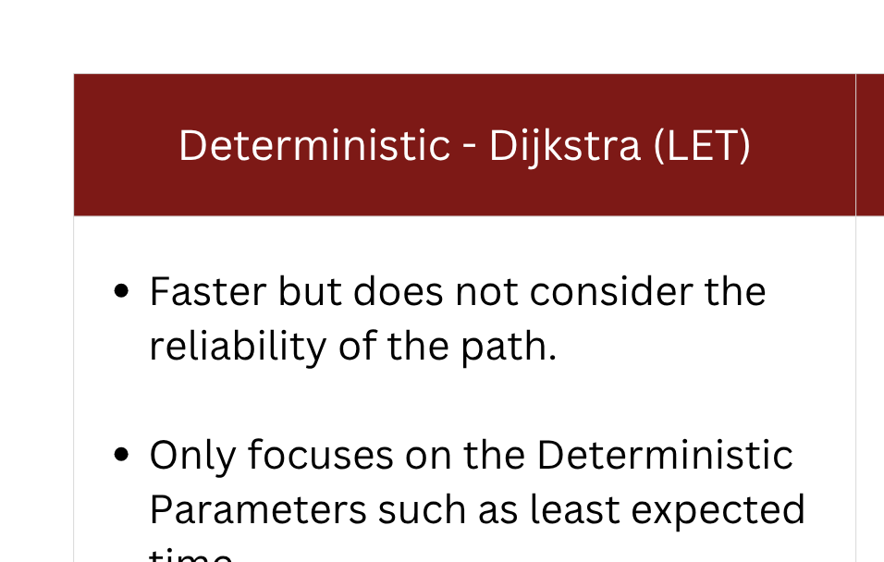
Result - 2
Comparison and Conclusion

Slide 26
Result - 3
Comparison and Conclusion
Our goal in this project is to maximize the probability for arriving under the budget.
Quality of the result holds more priority compared to the Quantity.
Hence, Dijkstra maybe faster in terms of complexity but the randomized algorithm considers the real world uncertainty.

Slide 27
Inference: Domain Perspective
In real-world transportation systems, minimizing expexted travel time does not guarantee reliable arrival due to uncertainty in edge travel times.
Deterministic routing (LET) gives optimal average but low reliability
Travel time variability significantly affects on-time arrival probability
Jensen’s Inequality highlights that expectation-based decision underestimate risk
Reliability-based routing (max P(T≤D)) better captures real-world uncertainty
Practical routing systems must prioritize robustness over average-case optimality
Expected Time ≠ Reliable Arrival

Slide 28
Inference: Computer Science Perspective
• Paradigm Shift
Deterministic → Probabilistic
Mean → Reliability
• System Design
Handles uncertainty
Risk-aware decisions
• Industry Impact
Google Maps / Uber / Ola
Reliable route > Shortest route
Tech Stack Insight
Graphs + Probability
A* + Dynamic Programming
• Trade-off
Deterministic: Fast, unrealistic
SOTA: Complex, reliable
• Key Takeaway
Optimize P(T ≤ D)
Reliability > Optimality

Slide 29
References and Source - 01
Problem Reference
Niknami, M. and Samaranayake, S. (2016). Tractable Pathfinding for the Stochastic on-time Arrival Problem. In: Springer. pp.231–245.
Bellman Reference
Roșu, I. (2002). The Bellman principle of optimality [Unpublished manuscript]. HEC Paris. Link
Haversine Reference
GeeksforGeeks. (n.d.). Haversine formula to find distance between two points on a sphere. Retrieved March 31, 2026, from GeeksForGeeks

Slide 30
References and Source - 02
Reference Repository :
Link
Our Repository
GitHub Repositroy link for the Deterministic Dijkstra Simulation
Link

